Slide 1
NYC Open Parking And Camera Violations IS362 Final Project
By Sanam Maharjan & Praveen Lama

Slide 2
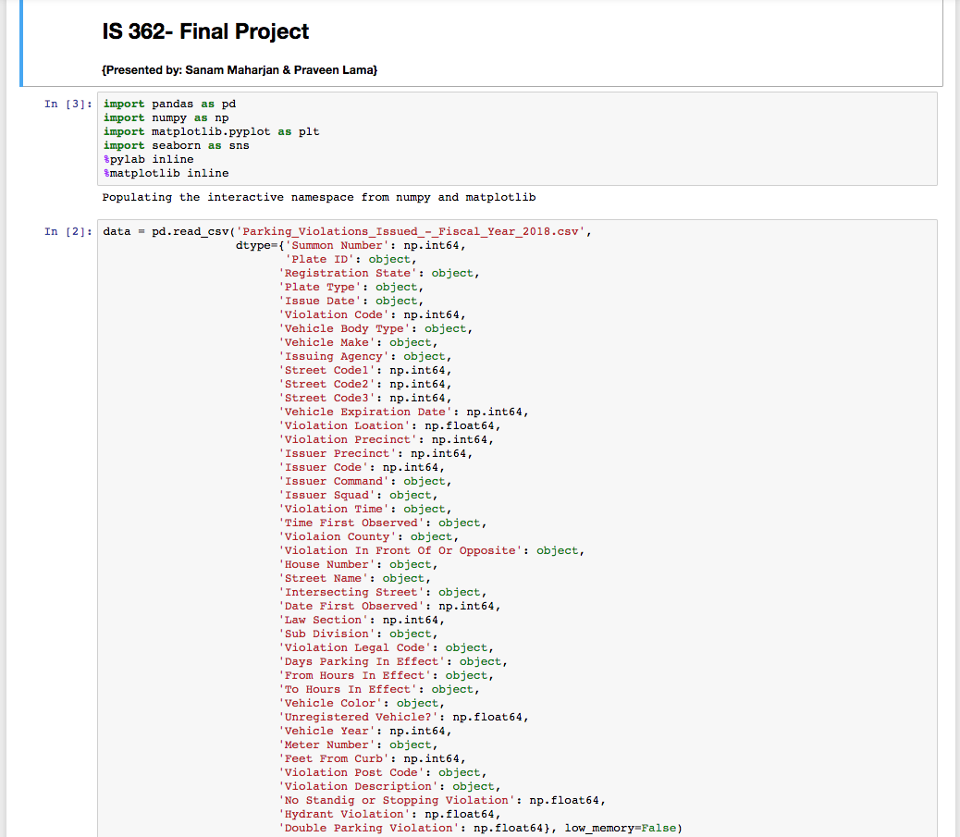
Populated Parking Violations data from .csv file for the fiscal year 2017-2018

Slide 3
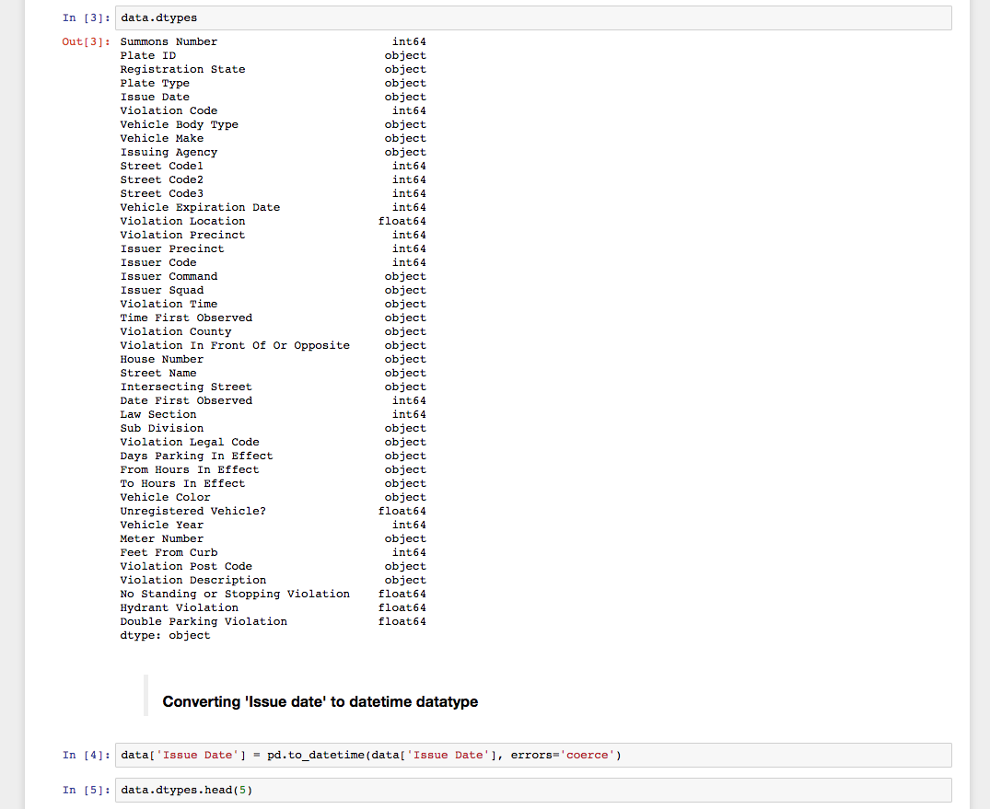
Checking for data types to understand information stored in .csv file.
Converting Issue date to datetime datatype for proper data format.

Slide 4
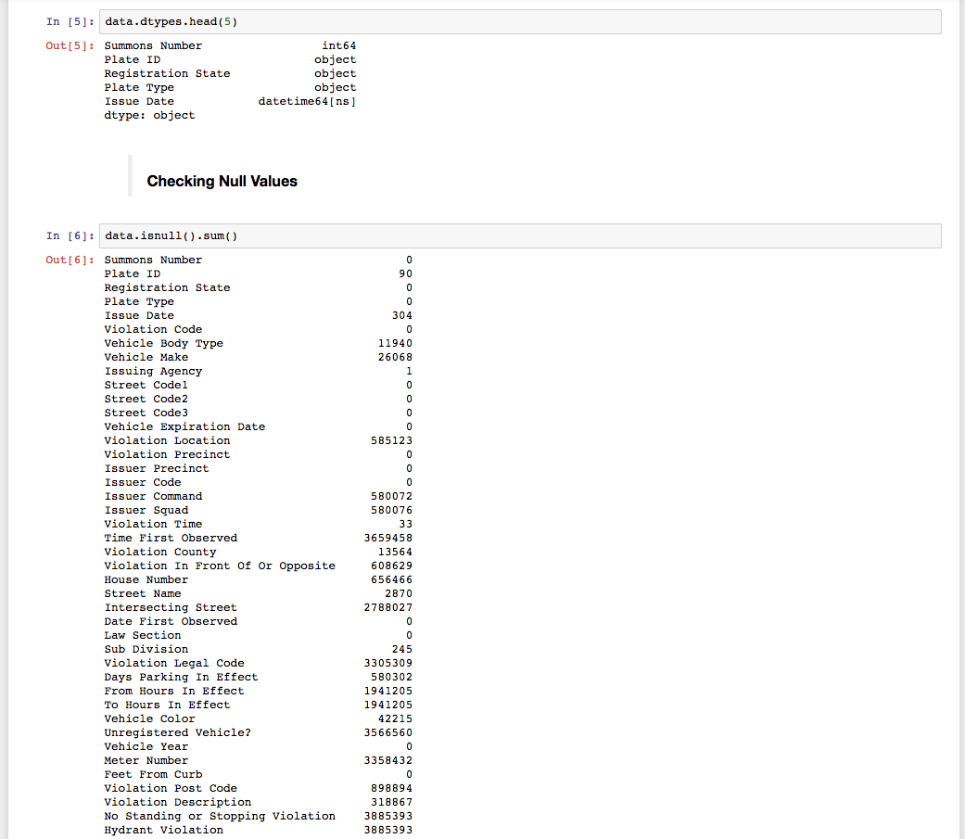
Cleaning data for Null values to assure the data accuracy and formatting the data.

Slide 5
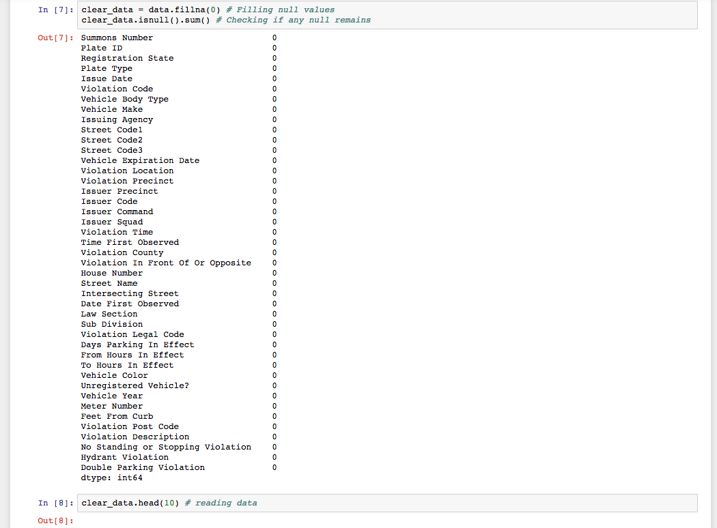
Replacing Null Values and double checking for remaining Null Values.

Slide 6
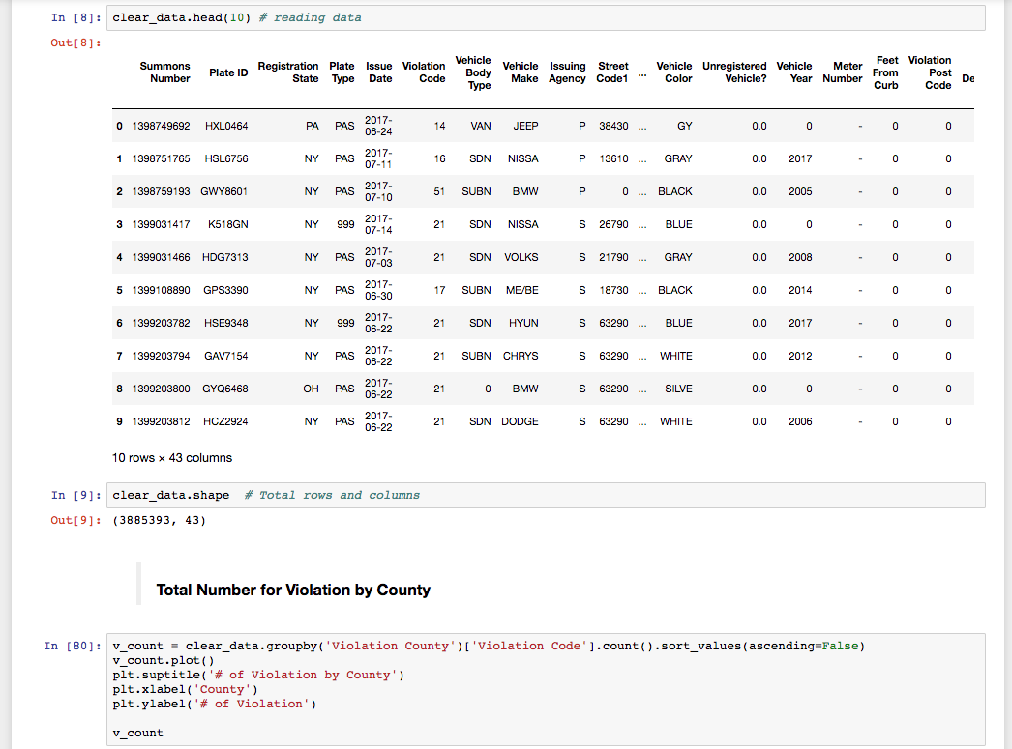
Reading Data and counting number of rows and columns. Findings : 3885393 Rows and 43 Columns.
Then, counting the number of violation by county.

Slide 7
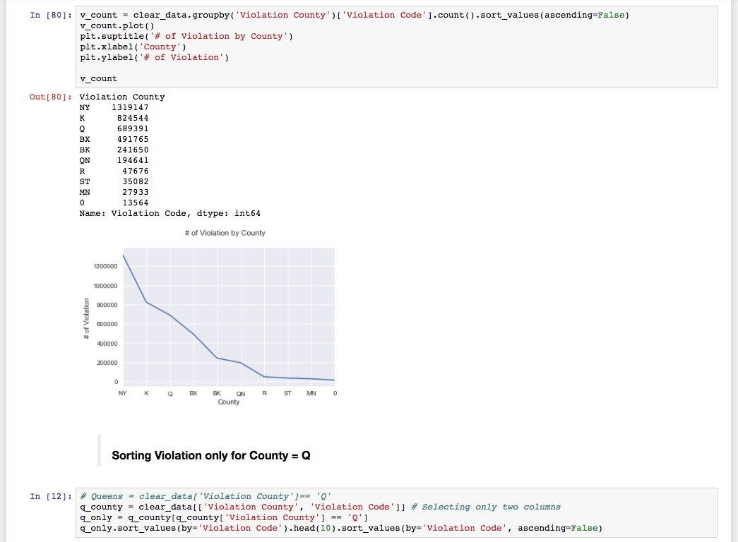
Data and Chart showing number of Violation by County.
Then, Sorting Violation for Queens County Only.
And, Selecting only Violation county and violation code column to sort for easy access and to read.

Slide 8
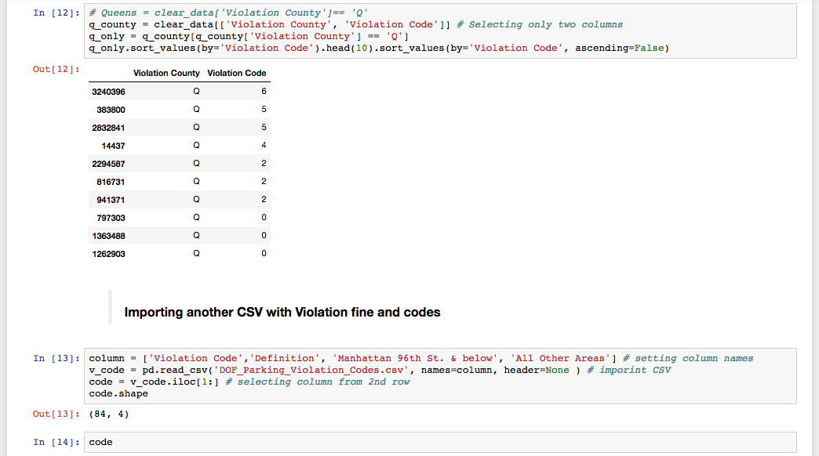
Selecting Only Violation County and its violation Code.
Then, Populating another .csv file with Violation fine and code to set column names.
Then, selecting all the columns from 2nd row to avoid the headings.

Slide 9
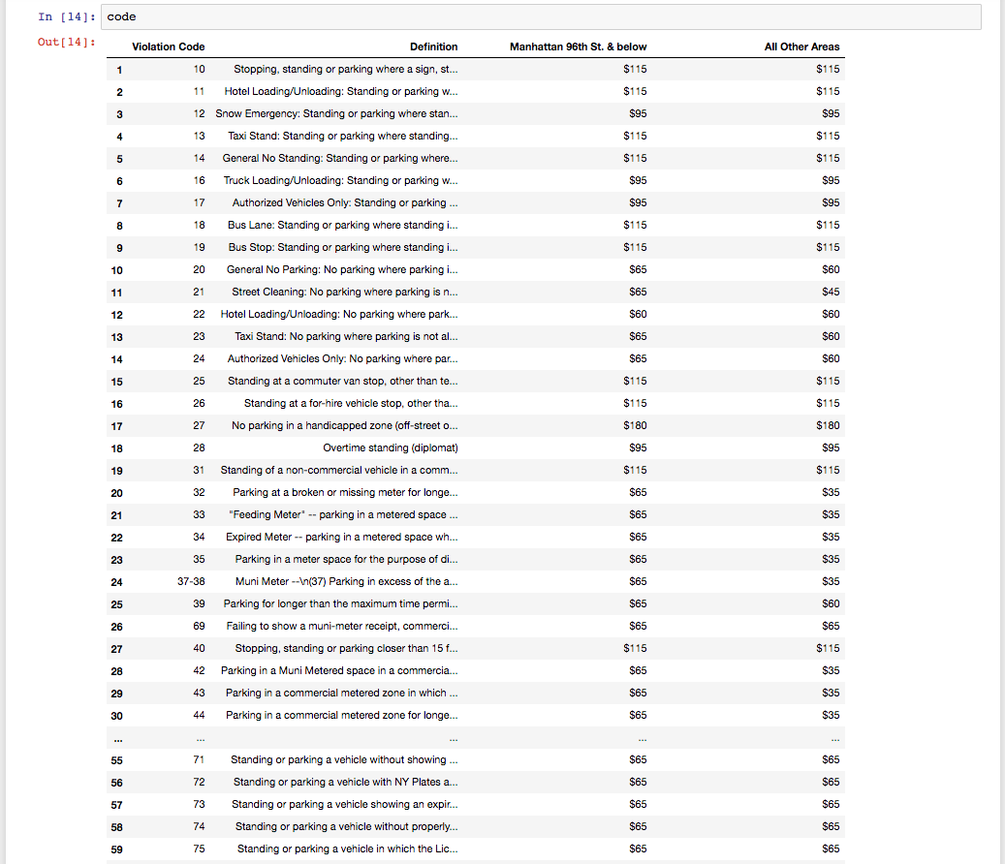
Displaying data in dataframe view to understand and further process the data.

Slide 10
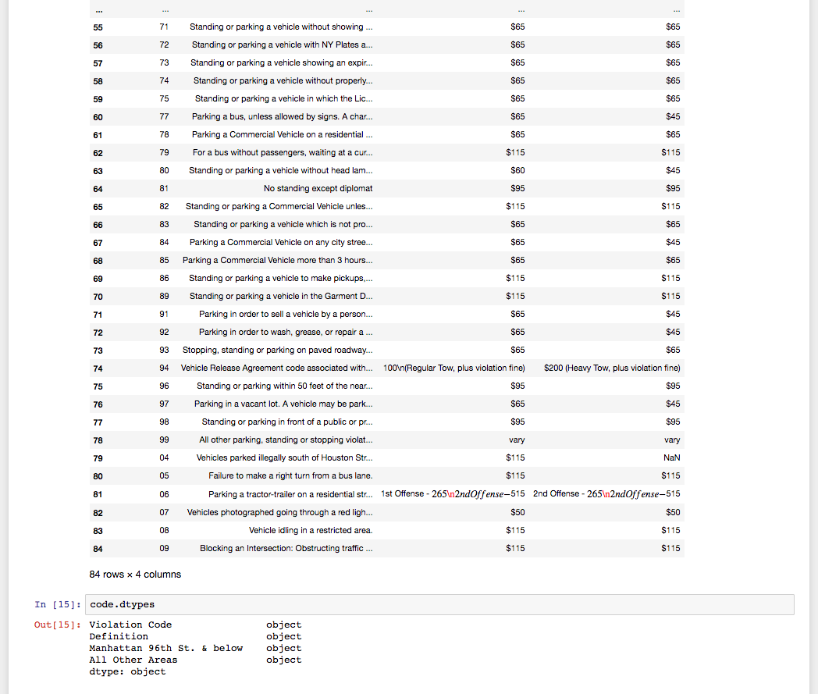
Checking for data type
Discovery - all columns are object

Slide 11
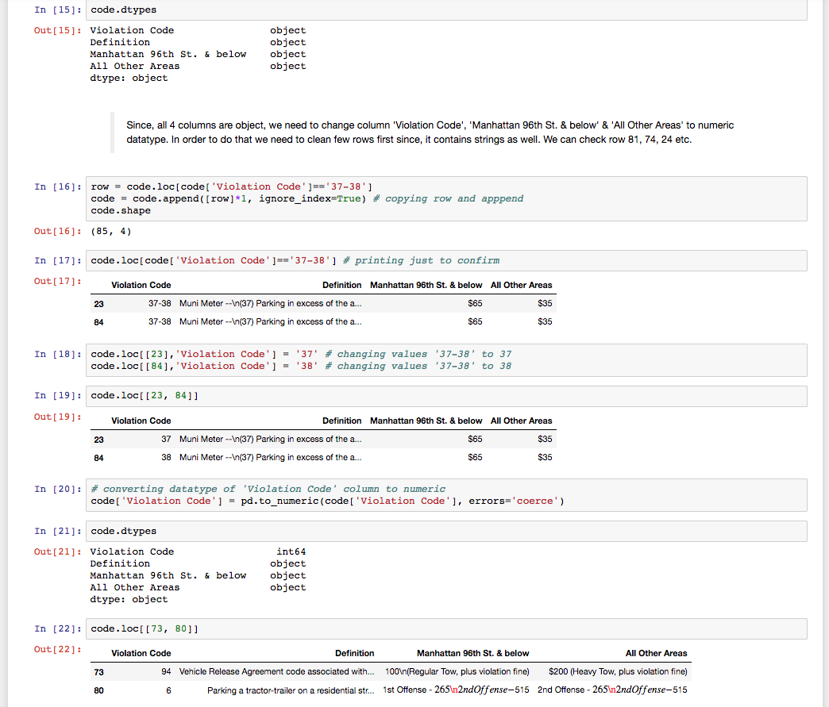
Changing certain columns to numeric data type, since we need them to analyse and process further.
Cleaning data and changing data type to numeric.
Further, separating merged data to individual data in order to maintain accuracy.

Slide 12
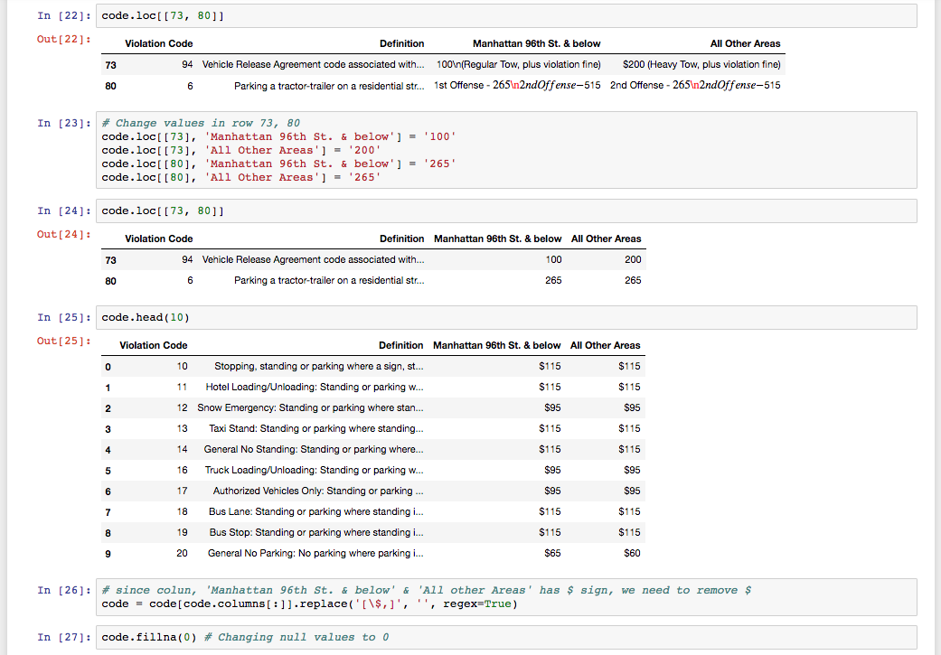
Further cleaning to remove “$” sign to have numeric values which in return will help in data processing.
And, further replacing Null values to Zero.

Slide 13
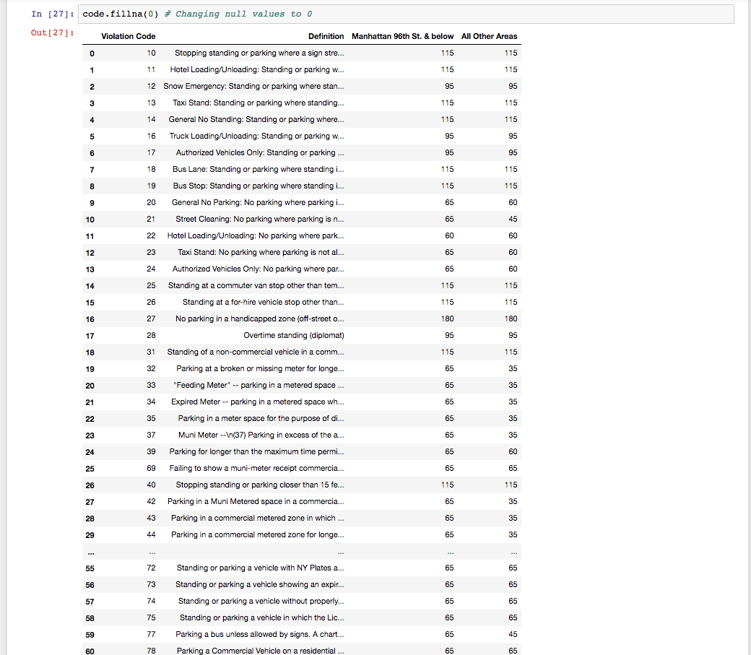
Cont…
Replacing Null values to Zero.

Slide 14
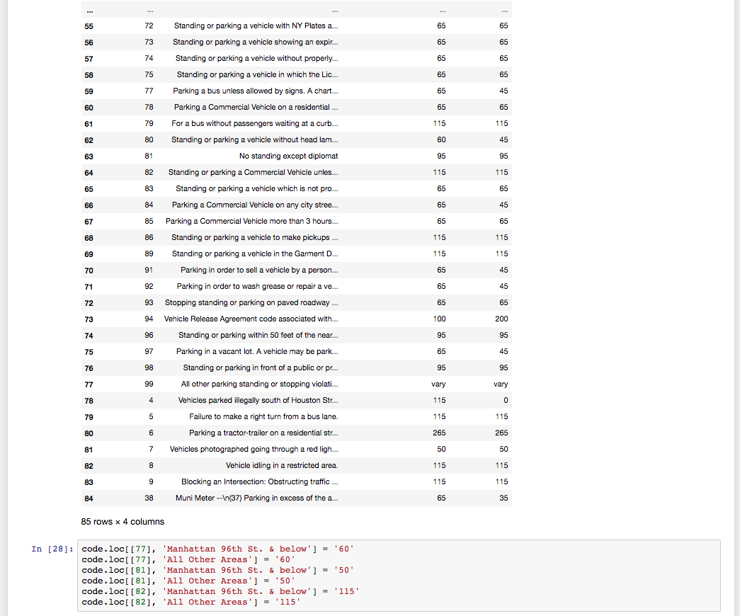
cont...

Slide 15
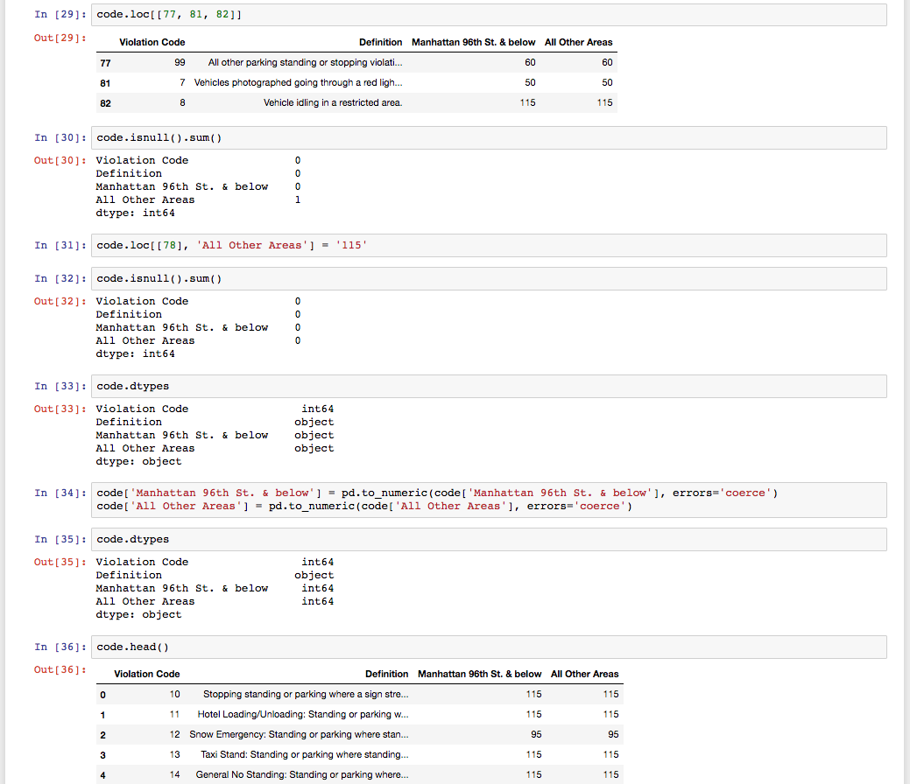
Double checking for data type for accuracy and further cleaning…
Further, converting data type to numeric.

Slide 16
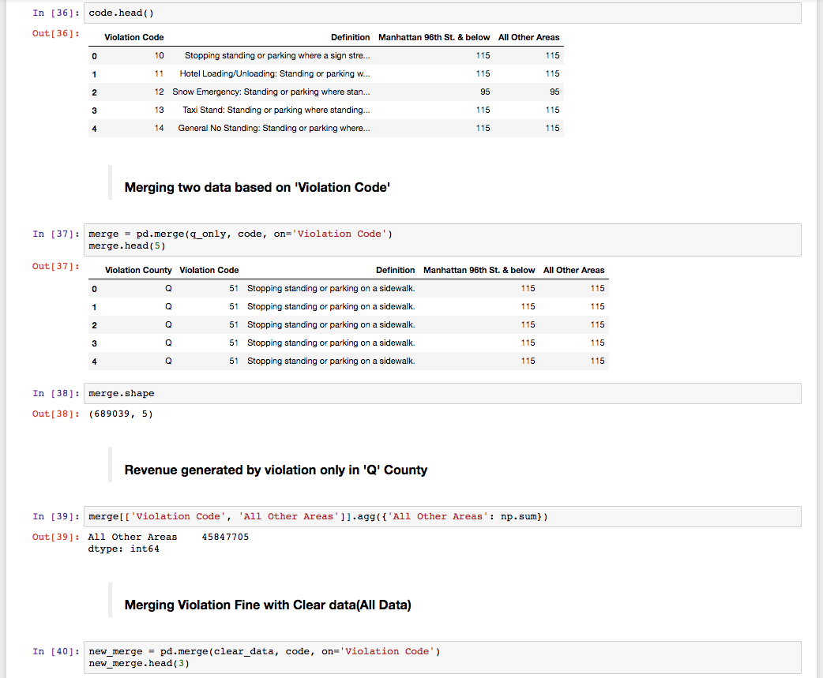
Merging two dataset to one based on “Violation Code”.
Revenue generated based on violation code in Queens only; Finding: $45,847,705.
Further, Merging violation fine with clean data

Slide 17
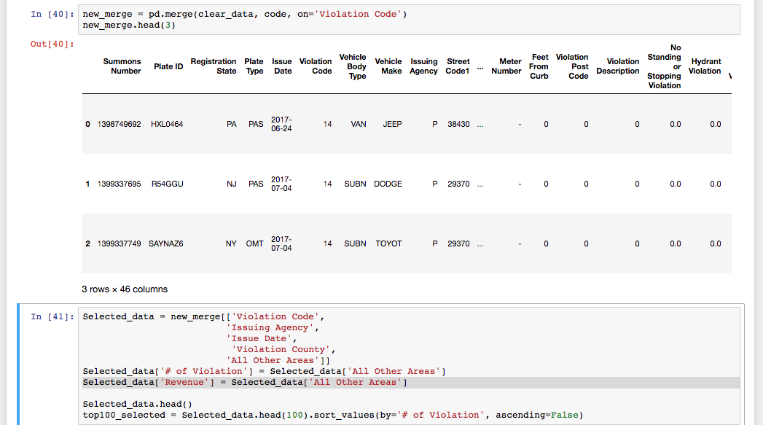
Viewing the merger data.
Selecting 5 columns: Violation Code, Issuing Agency, Issue Date, Violation County and All other Areas, to further analyze data.

Slide 18
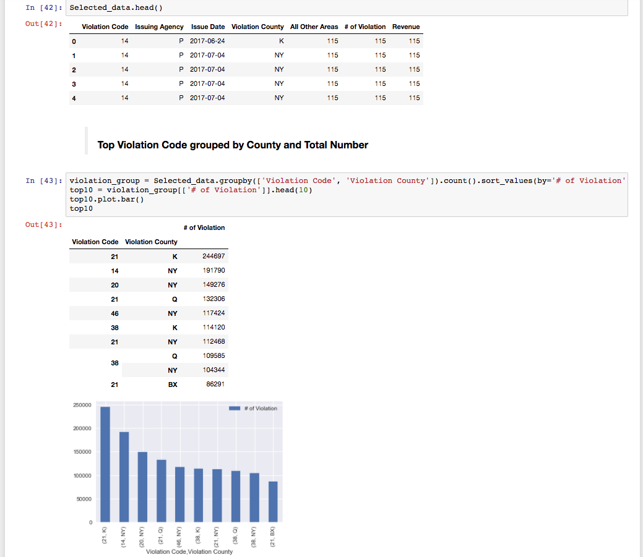
Finding top ten violation code with County and Total numbers of violation.
Based on finding, Violation code 21 - “Street Cleaning: No parking where parking is not allowed by sign, street marking or traffic control device. ” has received the most summons in the fiscal year 2017-2018.

Slide 19
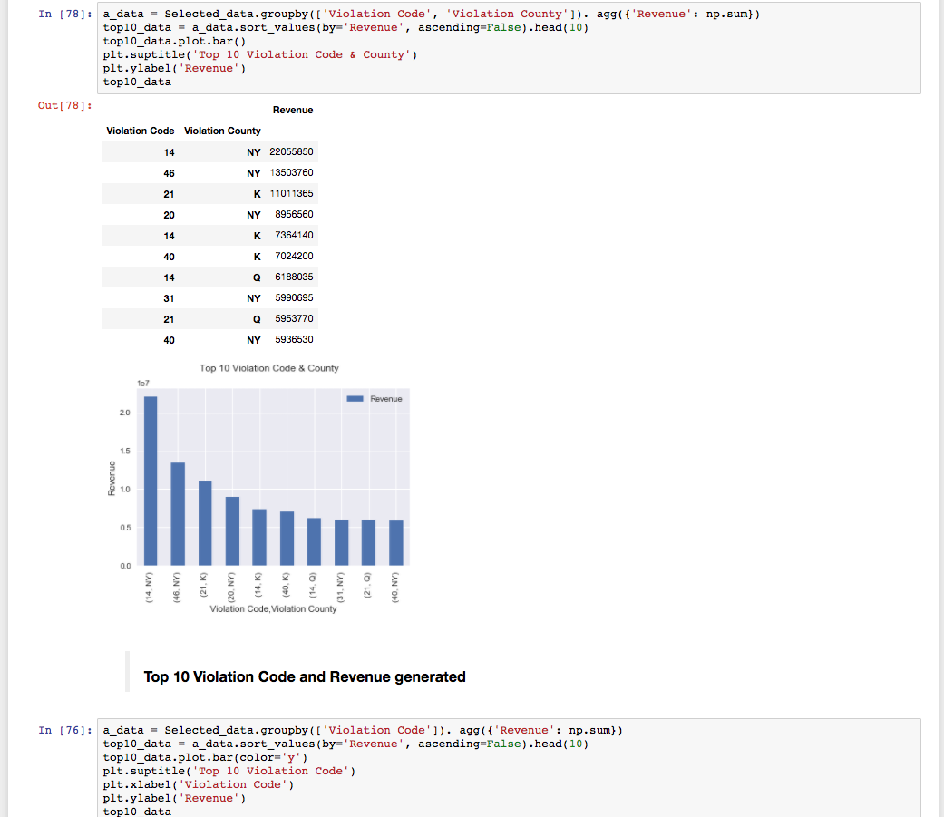
Finding Revenue Generated in County by Violation code.
Finding: Although code 21 is the most received summons, code 14 - “General No Standing: Standing or parking where standing is not allowed by sign, street marking or; traffic control device.” is the one that generates the most revenue because the Amount for code 14 is $115.

Slide 20
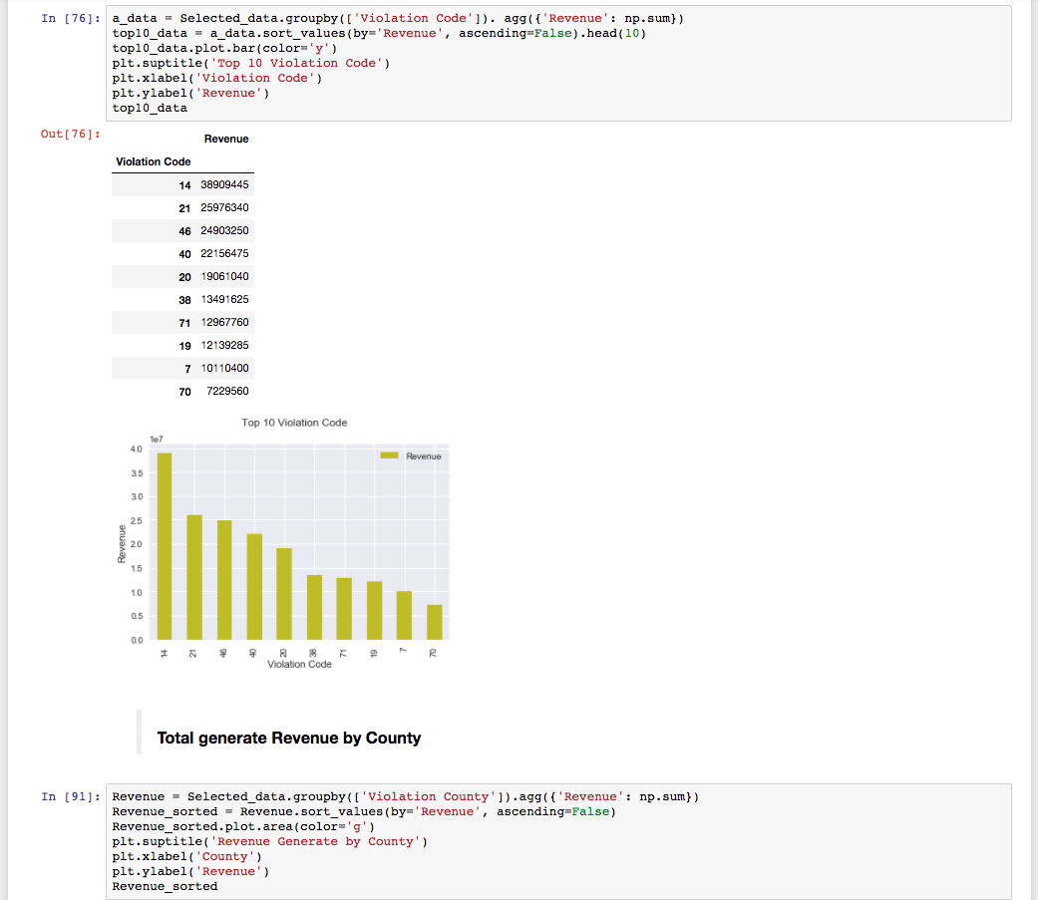
Displaying top ten violation codes with revenue generated in dollars.
Note: See file “DOF_Parking_Violation_Codes.CSV” for code reference.
Total Revenue generated by county.

Slide 21
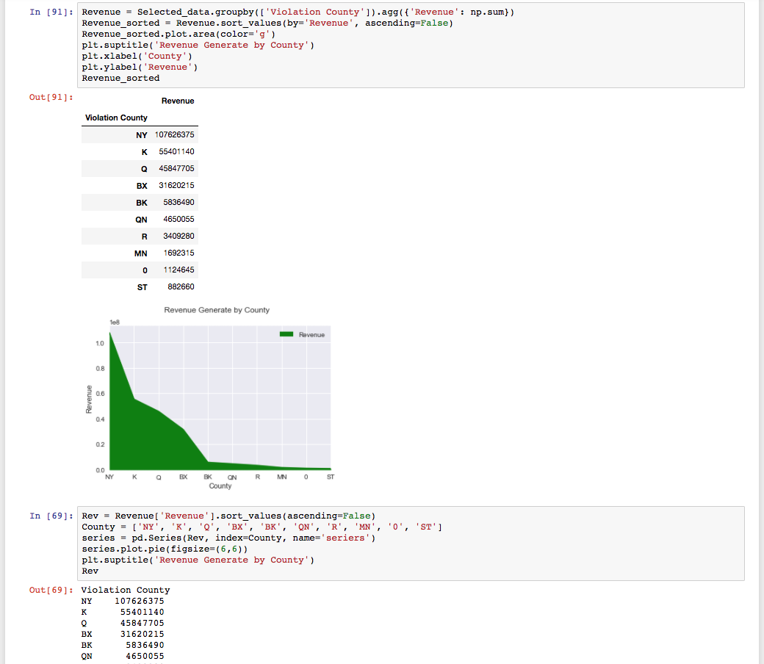
Sorting county by Revenue generated.
Finding: County Code NY generates the most revenue, whereas, County Code ST generates the least.

Slide 22
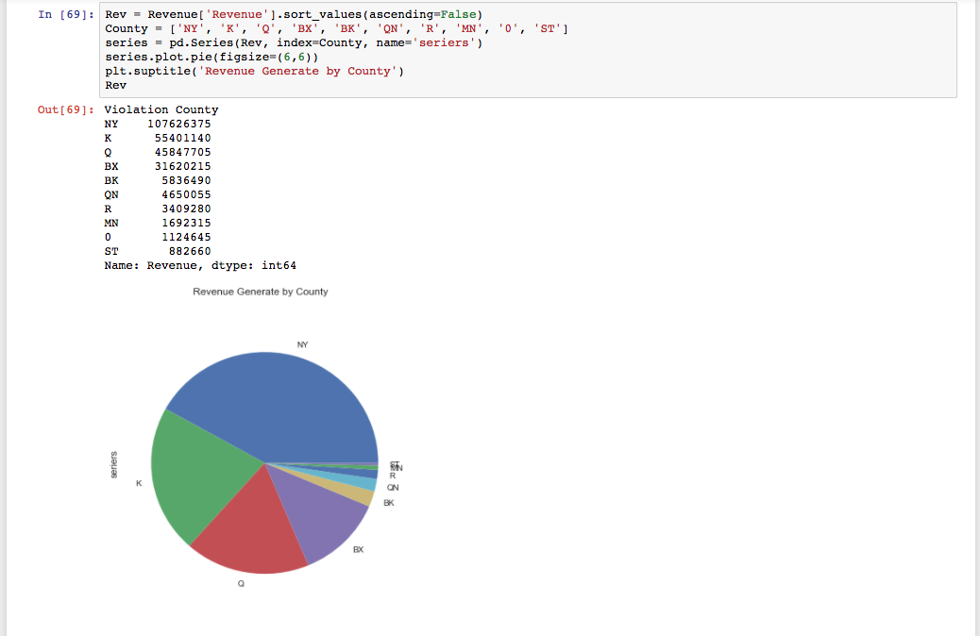
Presenting data in Pie Chart.

Slide 23
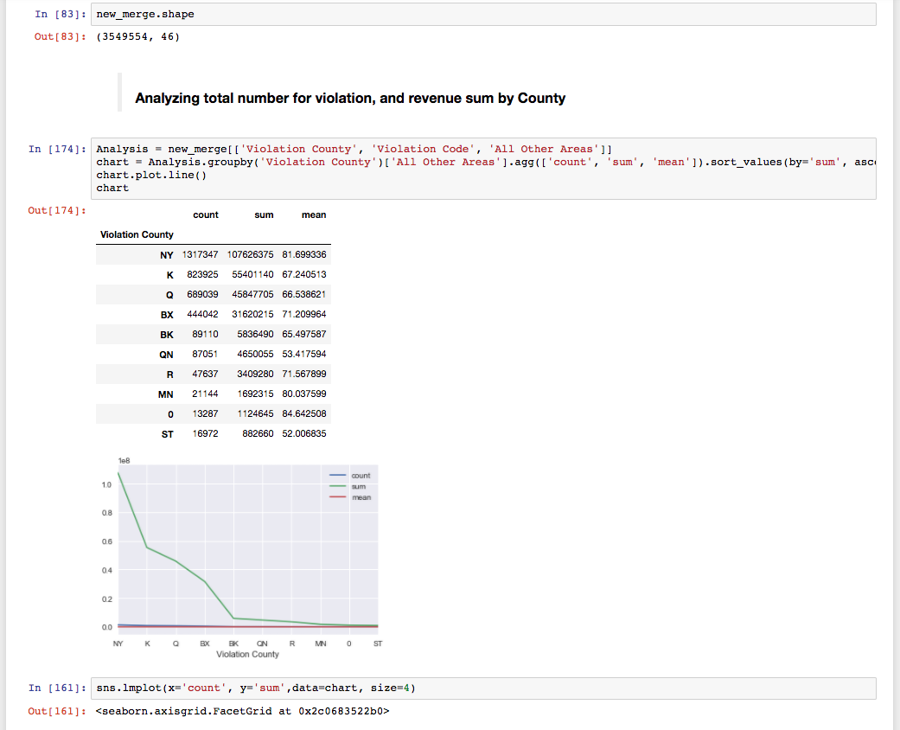
Presenting Total Violation , Revenue generated and Average Fine per summons that includes all Violation Code in single chart for better understanding.
Finding: County Code NY generates the most which average summons fine is $81.70 and County Code ST generates the least with average summon fine of $52.07.

Slide 24
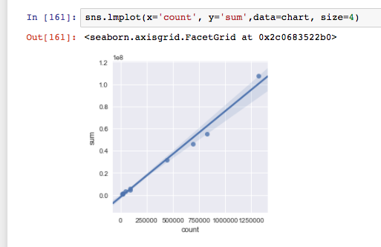
Presenting same data in Grid Chart.
Conclusion:
County Code NY generates the most revenue, whereas, County Code ST generates the least.
County Code NY generates the most which average summons fine is $81.70 and County Code ST generates the least with average summon fine of $52.07.

